Slide 1
Advanced Data Wrangling

Slide 2
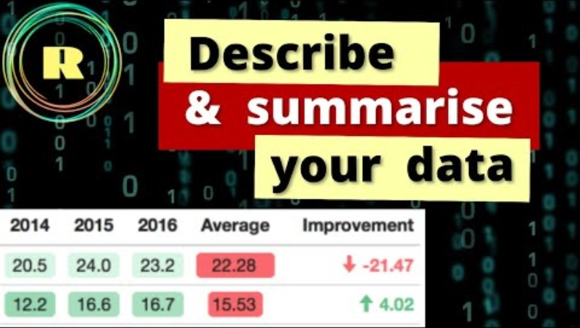
Describe and Summarise your data (19:43)

